Slide 1
Your
CARTOON
Is
Lee You Jin
Park Sung Chun
Lee Hyun Soo
Jang Hyung Joo

Slide 2
Subject
About GAN
Contents
GAN’s Limit
Paper Analysis
Q&A

Slide 3
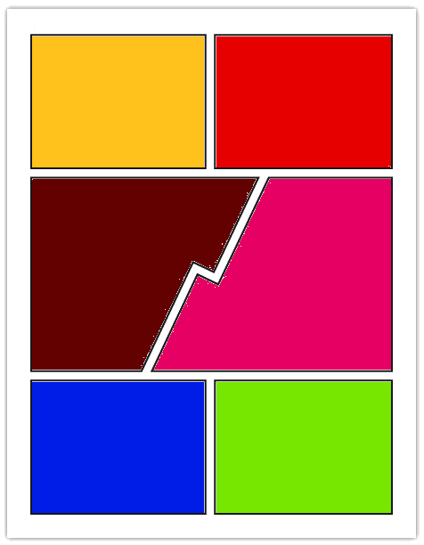
Subject
Extract highlight Frames
All video Frames
GAN
Make a cartoon
Cartoonization

Slide 4
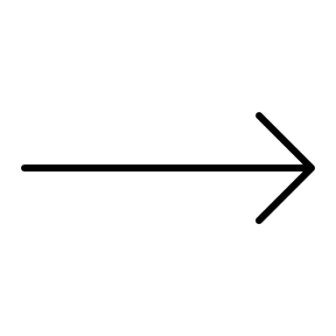
About GAN
Generative
Adversarial
Network
GAN is a Generation Model.
GAN competes and develops
two adversarial models.
GAN is made of
Artificial Neural Network.

Slide 5
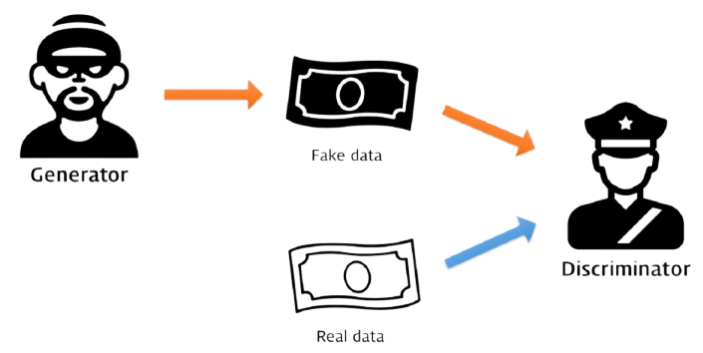
About GAN - Example
Generator :
How do I fool the Discriminator?
Adversarial Training
Discriminator :
How do I determine
the real data and the fake data?

Slide 6
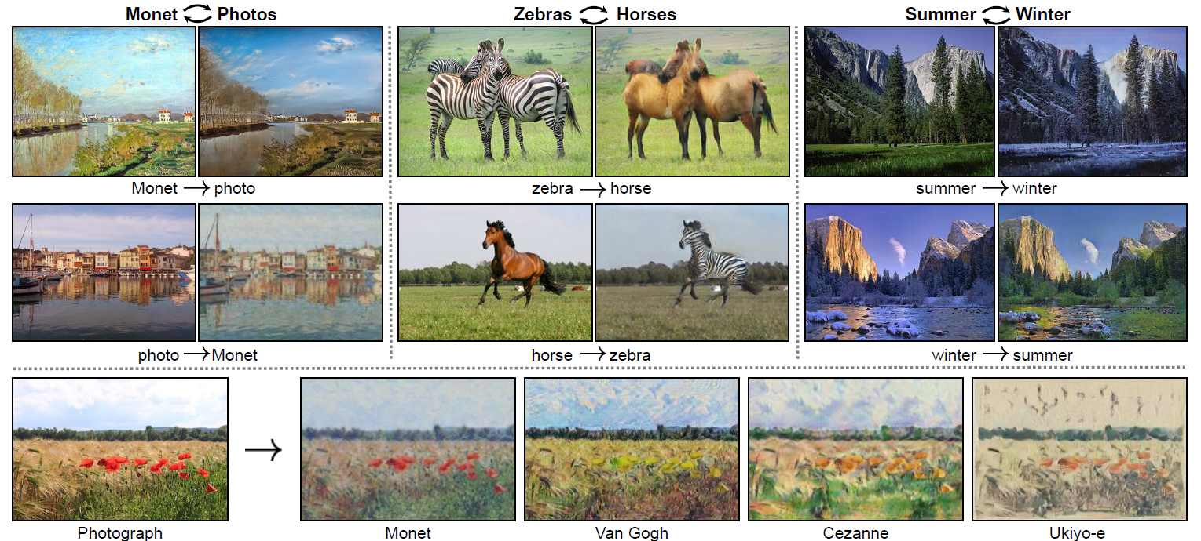
About GAN in Image Translation
What is Image Translation?
Unpaired Image-to-Image Translation using Cycle-Consistent Adversarial Networks - Berkeley AI Research (BAIR) laboratory, UC Berkeley

Slide 7
Cycle-GAN’s Limit
The instance of cycle-GAN is only matched 1 by 1.
If cross-domain relations become more complex, GAN can't get a good grasp of cross-domain relations.
The shape of instance does not translated well.
E.g. When cycle-GAN translates Zebra instance to Giraffe, it doesn’t function well.
Only instances except background are not translated clearly.
Multiple instance are integrated and then translated.
It makes cycle-GAN not work well.

Slide 8
Paper Analysis
Video Key-Frame Extraction using Unsupervised Clustering and Mutual Comparison
International Journal of Image Processing (IJIP)2016
INSTAGAN: INSTANCE-AWARE IMAGE-TO-IMAGE TRANSLATION
Published as a conference paper at ICLR 2019
Cartoon GAN: Generative Adversarial Networks for Photo Cartoonization
The IEEE Conference on Computer Vision and Pattern Recognition (CVPR), 2018
LARGE SCALE GAN TRAINING FOR HIGH FIDELITY NATURAL IMAGE SYNTHESIS
Published as a conference paper at ICLR 2019

Slide 9
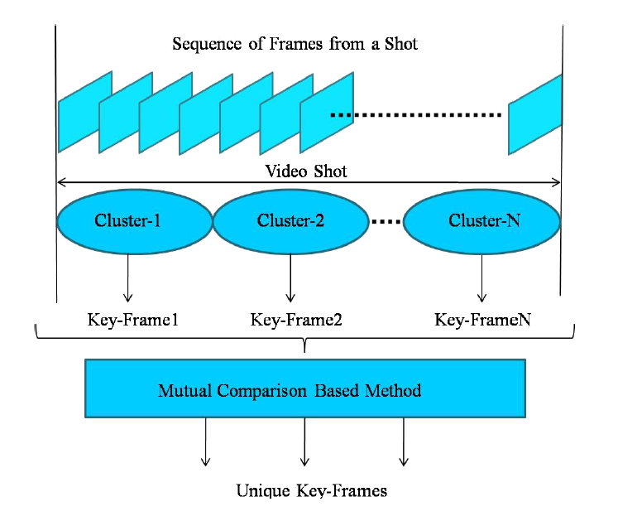
Key Frame Extraction
Use Cluster-X
if Cluster-X’s size is bigger than 10% of the number of frame.

Slide 10
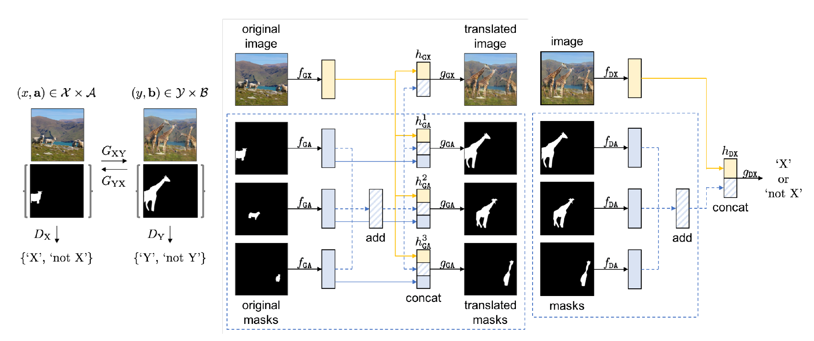
Insta GAN
Focus on each Instance.
Define a context preserving Loss $L$ for keep the background context as it is.

Slide 11
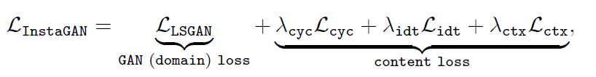
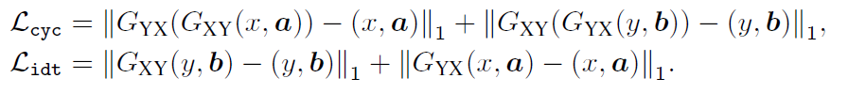
Insta GAN
Context Preserving Loss
It's used to convert only target instances and keep backgrounds original.
Total Loss of Insta GAN

Slide 12
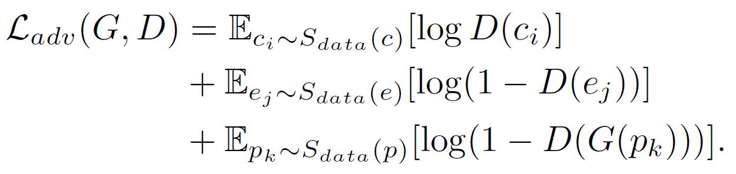
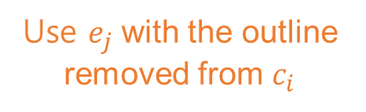
Cartoon GAN
Compared to the real photo, Cartoon has a soft color and sharp outline.
A sharp outline is an important feature in Cartoon.
But this feature occupies a low proportion in overall image.
So, Cartoon GAN define Edge-Promoting Loss that increases the weight of outline.
Use $e_{j}$ with the outline removed from $c_{i}$

Slide 13
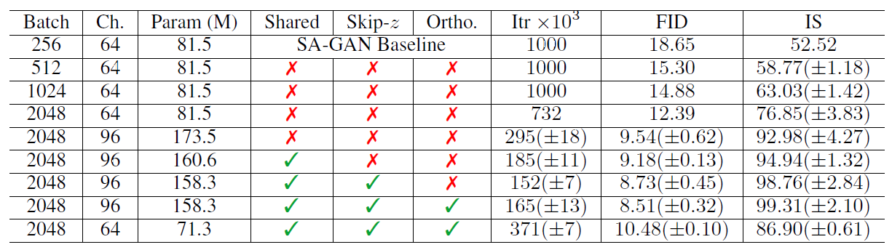
Large Scale GAN
After Image Translation, the resolution of image drops.
Large Scale GAN uses Scaling UP and TRUCATION TRICK
to increase the resolution of image.

Slide 14
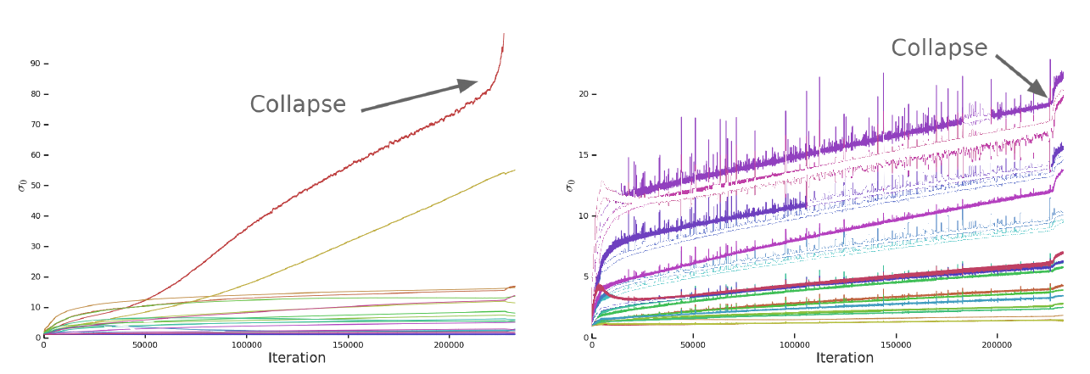
Large Scale GAN
Limits
Large Scale GAN trains models by increasing batch size and the number of Parameter
to increase the resolution of image.
So, it uses a great deal of GPU Memory, namely its cost is too high.
And GAN has a problem that models become unstable
as they grow in size and then eventually collapse.

Slide 15
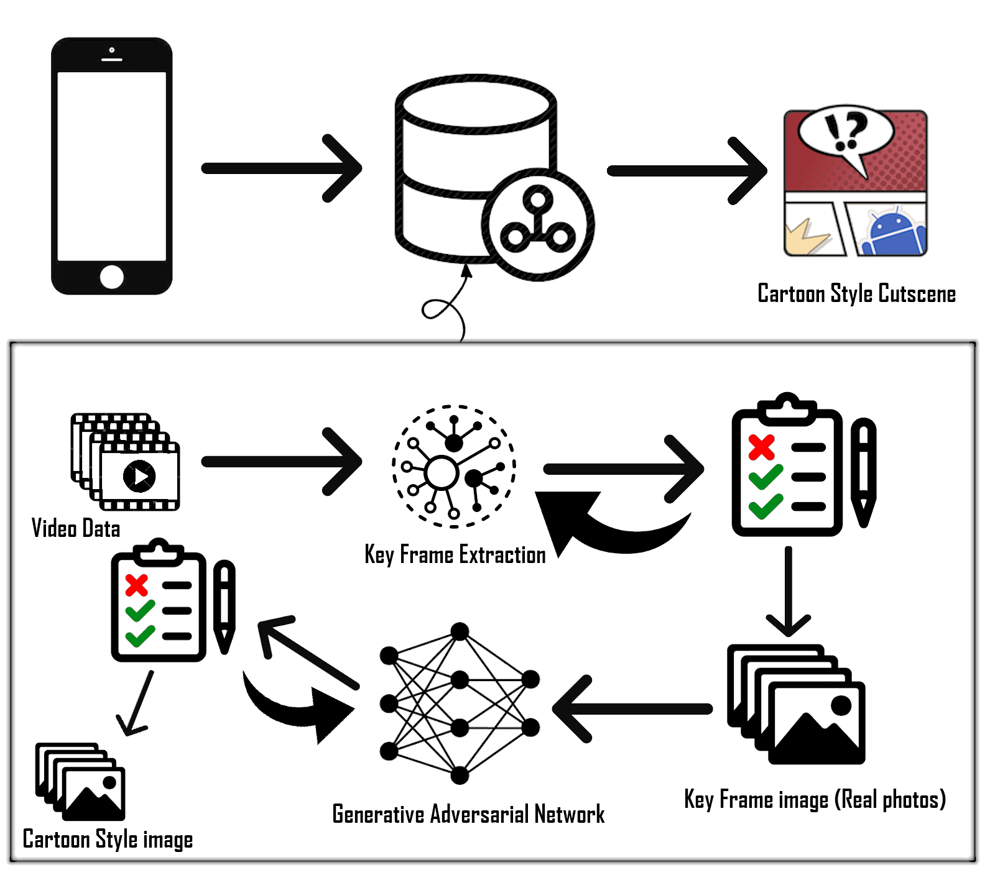
Conclusion

Slide 16
QnA

